Slide 1
UHV-I Session 9 Fulfilment in Relationship – Trust
Shifting from reaction to response in relationship…

Slide 2
Interaction Before Main Session
Hear from participants about their exploration from previous day(s)
Q&A
Place some expected conclusions, find out if they also came to these/similar conclusions

Slide 3
Home Assignments
8.1. How many persons, in your family and friends, do you have trust on intention (natural acceptance) – unconditional, continuous?
You always make effort to improve mutual competence
(your own competence as well as the competence of the other)
rather than getting irritated, angry or having a feeling of opposition
(even for a moment)
8.2. In case you get angry/irritated:
Do you feel happy when you get angry? And when you express your anger?
What is the outcome when you express your anger? Is it mutual happiness?
What is the reason for your anger? Is it the other or you?
8.3. Talk to 2 close friends you may have lost, due to lack of trust. Tell them you have realised the difference between intention and competence… and that you want to reconnect. Write down their response or reaction – you may like to share it in the next session

Slide 4
UHV-I Session 9 Fulfilment in Relationship – Trust
Shifting from reaction to response in relationship…

Slide 5
Right Here Right Now
Watch the short film "Right Here Right Now"
It is about human behavior directed by Anand Gandhi
Source:
Part 1: https://www.youtube.com/watch?v=OVAokeqQuFM
Part 2: https://www.youtube.com/watch?v=gIYJePEnvUY
We will discuss your observations:
Interactions with each other – reaction or response?
Are the actions indicating right understanding, trust?
Your own interactions, your own state and what you can do to further develop yourself

Slide 6
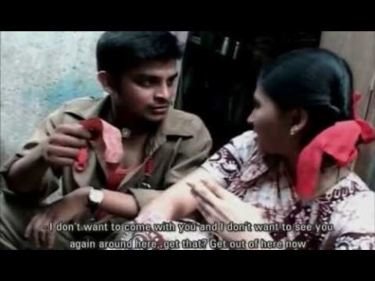

Slide 7
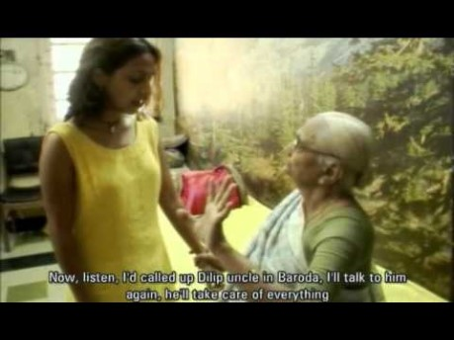

Slide 8
Discussion
Even a single happy person has an impact on others
Similarly an unhappy person has an impact on others

Slide 9

Reaction
Response
You decide your feeling based on the behavior of the other
Your feeling depends on whether you like or dislike the (taste of the) behavior of the other
If the other behaves properly, you have a right feeling and may behave properly
If the other misbehaves, you have a wrong feeling and you may also misbehave
Your “remote control” is with the others
You are “enslaved”
Your conduct is indefinite
You decide your feeling on your own right
It is based on right understanding
You always have the right feeling
It is definite and unconditional
The behavior of the other is only an indicator of the state of the other
With that input you decide your behavior to ensure mutual happiness
You decide your own behaviour
You are self-organised
Your conduct is definite

Slide 10
Evaluate the following – were they reactions or responses?
Grandmother telling Shruti to elope
Doctor helps injured boy
Shruti drops the bag when doctor does not arrive in time
Auto driver offers tickets to the maid’s daughter
Write 5 other interactions and evaluate them
Reaction?
It is influenced by Shruti’s likes rather than for the overall harmony in the family
It may make Shruti excited for some time, but what about Shruti’s father?
Response?
Reaction?
Doubt on intention, Lack of trust
Reaction?
Motivation was right feeling or pleasure?

Slide 11
Self Reflection
In your own interactions, find out
the % time you are responding
the % time you are reacting
What is the effort required to progress from reaction to response?
To develop the right understanding (at least about relationship)…
(this will be discussed further in this course and in detail in the UHV-II course)
To be aware of your imagination, develop the right feeling within
To “repair” the damage from past reactions

Slide 12
How are people deciding?
How did the grandmother decide that it is OK for Shruti to marry the doctor?
Why did the boy say “I love you” to Chahat
Why did the doctor decide to pick up the accident victim, even though he was getting late to meet Shruti?

Slide 13
Sum Up
Response is naturally acceptable, reaction is not acceptable naturally
Reaction could be positive or negative, but it is not based on right understanding, right feeling
We may be reacting inside, and may not be expressing it outside many times. But that is also reaction, and not naturally acceptable
Reaction is due to lack of assurance on the intention of the other
With trust on the intention of the other, we respond every time

Slide 14
Home Assignment

Slide 15
Home Assignments
9.1. Note your behaviour throughout the day
At home
In the school/college/workplace
List how many times you responded in your behaviour and how many times you reacted. Calculate the percentage of reaction and response in your behaviour.
9.2. Note any two situations where you reacted. Now explore to see what would have been your ‘response’ in those two situations everything else remaining the same.
9.3. Make a 3-5 member team and record on mobile a 1-3 minute skit about what you all understand about reaction-response

Slide 16
Questions?

Slide 17
Some Common Doubts and Confusions
In this world nobody is trustworthy (Don't Trust anybody)
If I Trust the other, the other will cheat me
Trust only those who trust you
Never start with Trust
?

